Slide 1
Slab Memory Allocator
Sébastien Tandel <sta@hp.com>

Slide 2
Agenda
Yet Another Memory Allocator?
Object-Caching Memory Allocator
  Basic Principles
  Internals
  Characteristics
Cache friendliness
References

Slide 3
Yet Another Memory Allocator?
Allocators tradeoffs :
  Space efficiency :
    fragmentation
    additional space for mgt
  Time efficiency
Keep in mind architecture constraints!
  Cache friendliness
Heavily used by components in a kernel
  Critical to optimize it for overall performance

Slide 4
Object-Caching Memory Allocator
Init/Destroy costs > Allocate/Free
  Gain to cache objects > optimize allocator
Slab built on top of this simple idea
  And is generally more efficient in space and time.
    Implemented in Solaris, Linux, *BSD, Haiku-OS … HP-UX ☺
    Note
    for multiprocessors/multithreaded env, exists SLUB (layers to Slab).
    Linux 2.6 defaults to Slub.

Slide 5
Basic Principles
Slab is a new interface to allocate/free objects
When object needed, will return one from the cache
  No alloc nor init time, just a pointer returned from a free list
When not needed anymore, simply tell the cache
  No destroy nor free done. Just internally added to a free list
Need for a new API ...

Slide 6
Basic Principles
At creation time, give following parameters :
  Cache name
  Object size
  Init object fn
  Destroy object fn
  (memory alignment)
One cache per object type

Slide 7
Basic Principles
Can be backend of « kernel malloc » (name it)
  Just create a serie of caches w/ different sizes
    Example :
    30 caches ranging in size from 8 bytes to 9K in 10-20% increments.

Slide 8
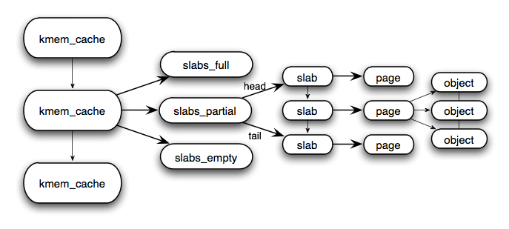
Internals

Slide 9
Internals
Each cache is
  Responsible for one kind of object
  Represented as a list of Slabs
One Slab manages objects on a page
  List of « in-use » / released objects

Slide 10
Internals
Slab States :
  Full, Partial, Empty
    Empty Slabs are not directly released to the kernel.
    Kernel can reclaim them *when needed*!

Slide 11
Internals
Slab structure kept :
  On page if size(object) / size(page) < 1/8
  else separate

Slide 12
Characteristics
Reclaiming unused memory is trivial
  Counter based (no trees, bitmaps, etc...)
Allocate/free fast and constant-time
Severe external fragmentation is unlikely
    unusable buffers
Internal fragmentation is minimal
    per-buffer wasted space

Slide 13
Cache friendliness
Cache-aware : key feature for performance
  Most allocators don’t care
BUT
  L1 hit ~ 1ns
  L2 hit ~ 5ns
  L3 hit ~ 10-15ns
  RAM ~ 110-120ns

Slide 14
Cache friendliness
Power-Of-Two allocators :
  Buffers are 2^{n} bytes and 2^{n}-byte aligned
    Example :
    Every inode objects are 300 bytes and 512-byte aligned
    Frequently accessed the first dozen fields (48 bytes)
      Memory traffic at addresses 0 and 47 modulo 512
      Means that 9% of the cache is usable
    Lot of mid-sized objects (100-500K) w/ most accesses fields grouped at the beginning of the structure.
    Bus imbalance :
      256-byte interleaving => two buses to retrieve contiguous 512 bytes
        BUT ... Only the first bytes are of interest
        Second bus is useless then …

Slide 15
Cache friendliness
Two aspects to check :
  Buffer Addresses distribution
  Cache footprint of allocator

Slide 16
Cache friendliness
Buffer addresses distribution :
  creation time :
    specify memory alignment
  page allocation time :
    Use a coloring scheme
      Start at a different offset for each page inside a cache
        based on «unused» space of a page because (page_size % object_size != 0)
    Also improves bus balance
      to the contrary of power-of-two allocators

Slide 17
Cache friendliness
Cache footprint
  Good cache locality
    Separate free lists for different buffer sizes
    Only small amount of pointers to load for whole ops
    Straightforward compared to sequential-fit / buddy-system allocators
  If small object size, everything resides on a single page! (no TLB miss)

Slide 18
performance
Summary :
  Outperforms any memory allocators
Details in paper : Object-Caching Kernel Memory Allocator (see references, next page)

Slide 19
References
Anatomy of the Slab allocator
The Slab Allocator : An Object-Caching Kernel Memory Allocator
The Linux Slab allocator
Overview of Linux Memory Management Concepts : Slabs

